Slide 1
The French and Indian War
Part 1-
The Expanding French Empire

Slide 2
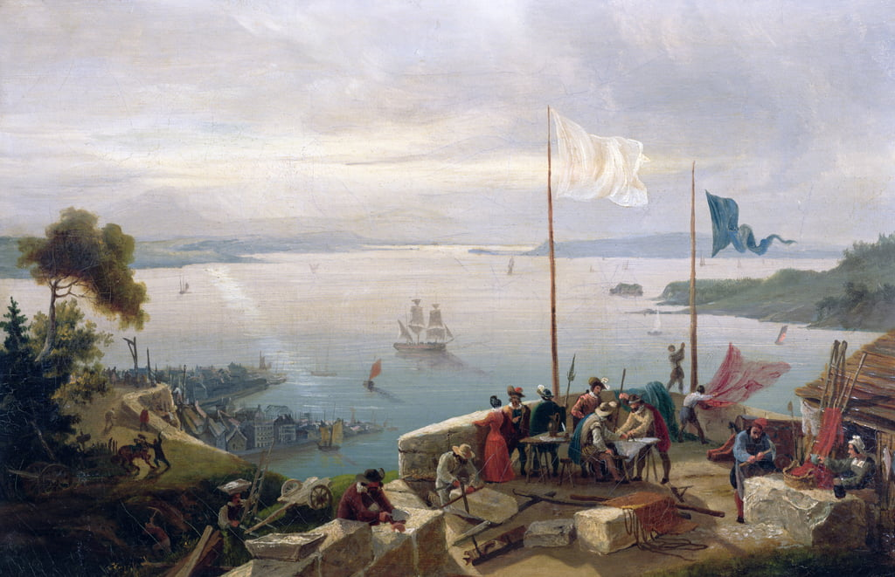
France gained a foothold in America when Samuel de Champlain started the fur-trading post of Quebec in 1608. This became known as New France.

Slide 3
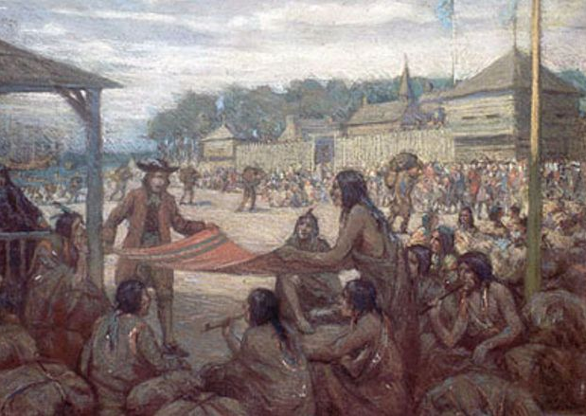
New France was the land around the St. Lawrence River and the Great Lakes. In 1642, farther upriver from Quebec, another fur-trading post was started named Montreal. Soon it would become the center of the fur trade.

Slide 4
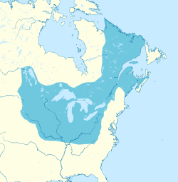
New France
Mid-1600s
Quebec
Montreal

Slide 5
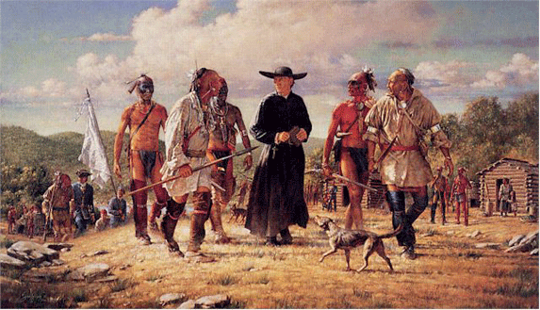
By the mid-1600s, most of the French living here were male fur traders and missionaries. Most of them were here only temporarily, unlike the English settlers who were making permanent homes in America.

Slide 6
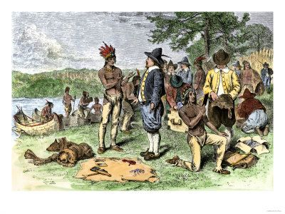
France’s North American empire was based on the fur trade.
How was this different than the Spanish or Great Britain?

Slide 7
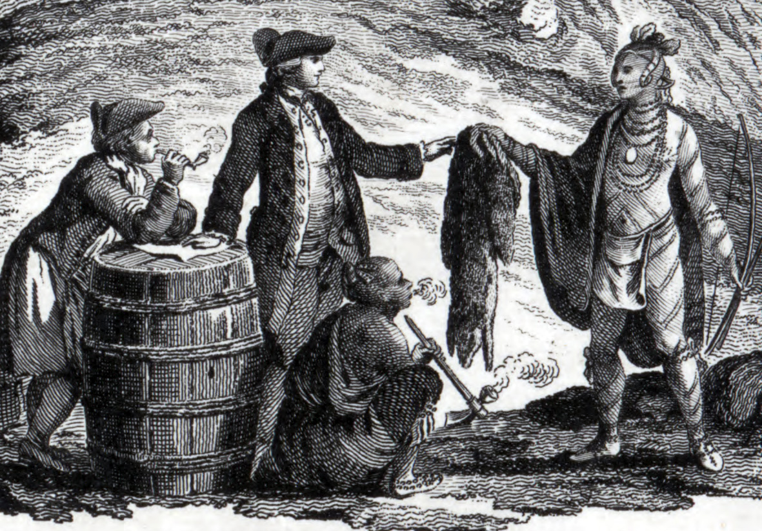
For the fur trade to be successful, France needed the Native Americans to cooperate with them. This affected how the French treated the Native Americans.

Slide 8
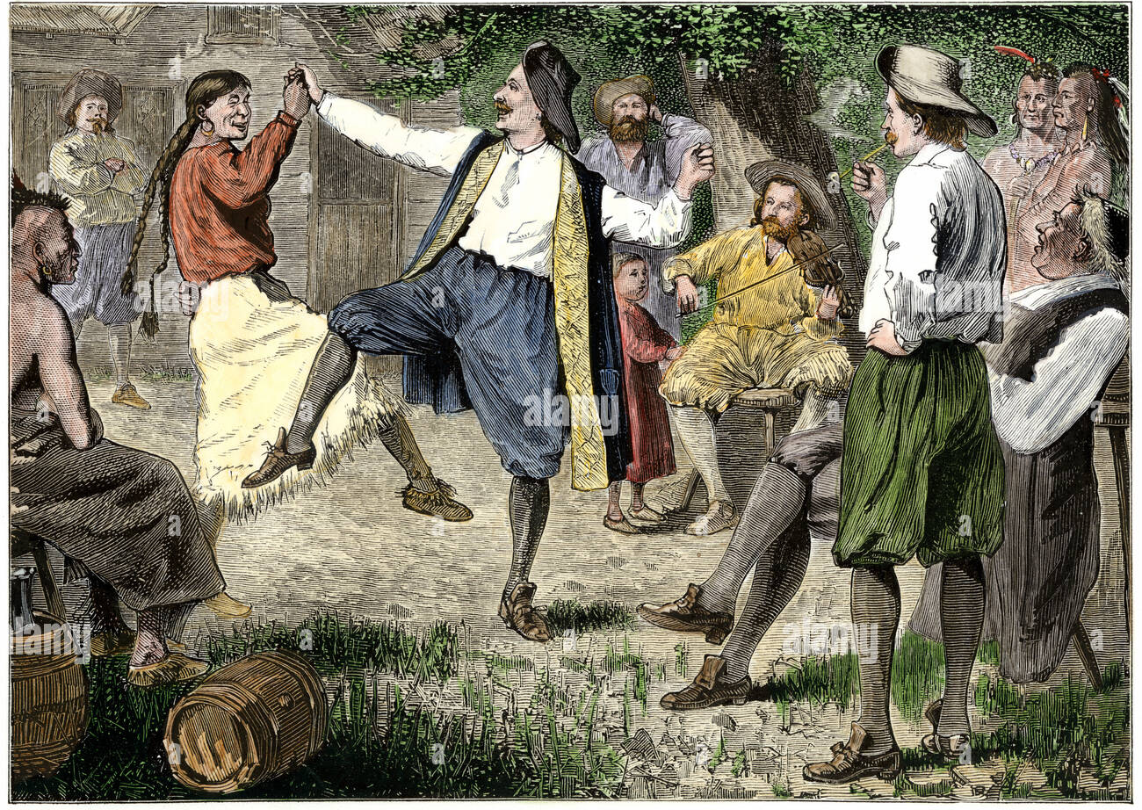
Typically, the French treated the Native Americans better than other Europeans. Fur traders got along with Native Americans, often living in Indian villages and marrying Native American women.

Slide 9
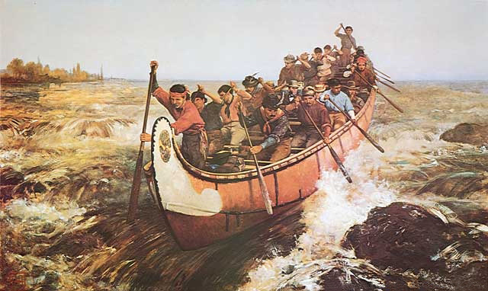
Voyageurs and canoeists were the well-known French fur traders in America.

Slide 10
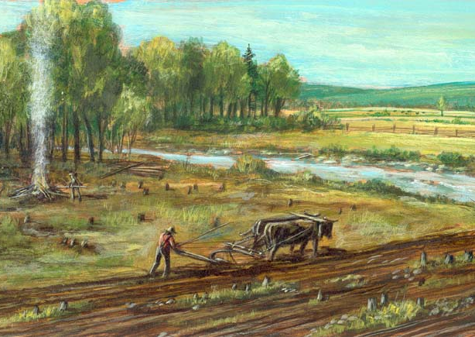
The government of France wanted to establish a permanent colony of farming families in the St. Lawrence River valley. They encouraged families to move to New France, and by 1700, the population grew to about 15,000 people.

Slide 11
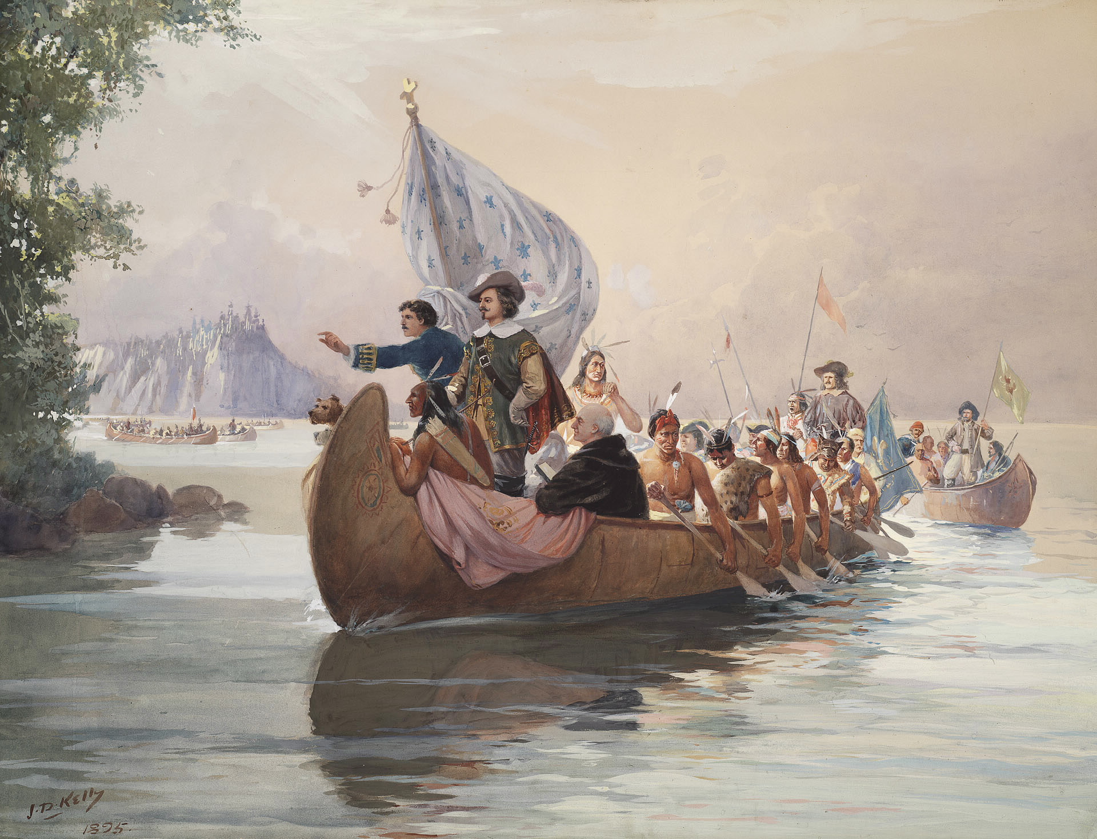
The French continued to explore North America with the goal of expanding their empire and possibly finding the Northwest Passage.

Slide 12
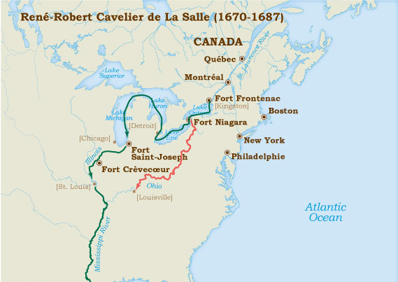
In 1669 a Frenchman named La Salle travelled from Lake Ontario south to the Ohio River and followed it almost to where it flows into the Mississippi River.

Slide 13
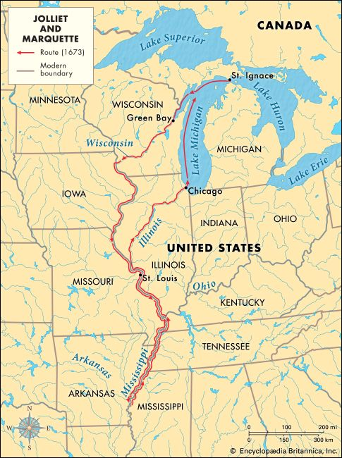
In 1673, fur trader Jacques Marquette and missionary priest Louis Joliet set out from Lake Michigan to the Wisconsin River and finally to the Mississippi River and travelled south as far as the Arkansas River.

Slide 14
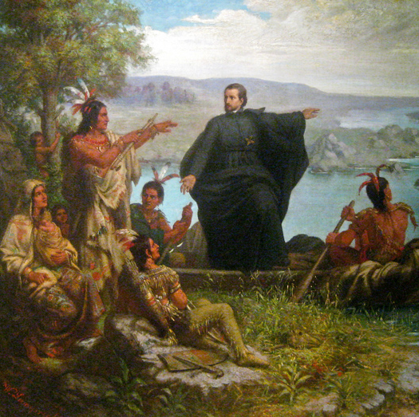
These expeditions came about from stories Native Americans told about unknown rivers and "great waters".

Slide 15
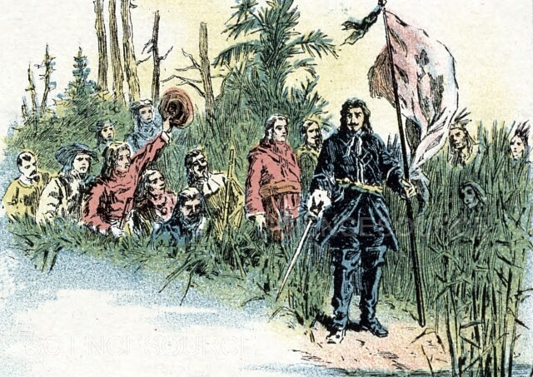
With information gathered from these expeditions, La Salle wanted to try to reach the mouth of the Mississippi River for purposes of colonization.

Slide 16
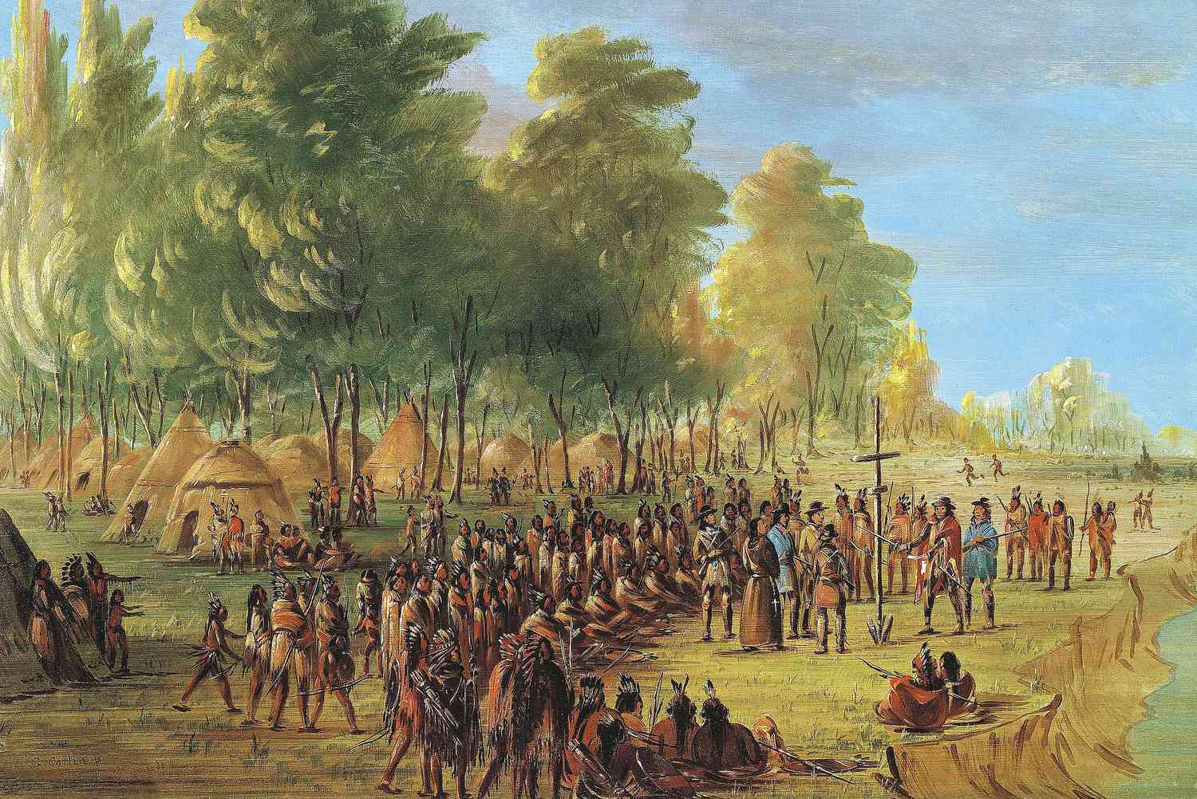
With permission from King Louis XIV of France, in 1679 La Salle and his team set out on their journey. In April of 1682, they reached the Gulf of Mexico.

Slide 17
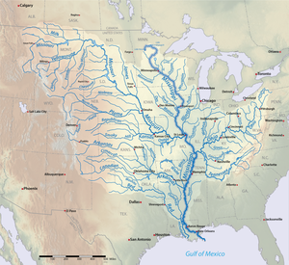
La Salle called all the land of the Mississippi drainage basin from the Great Lakes to the Gulf of Mexico Louisiana.

Slide 18
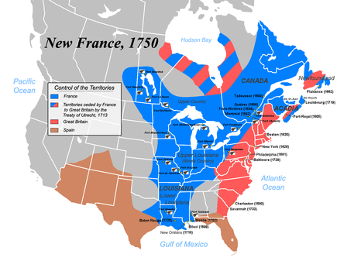
La Salle wanted to build a string of forts along the Mississippi from the Great Lakes to the Gulf of Mexico.
Why do you think France would want to do this?

Slide 19
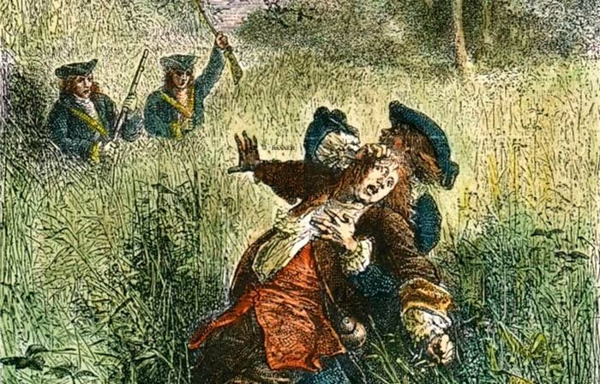
In 1684, La Salle set out to build a fort at the mouth of the Mississippi, but his expedition met with disaster and his own crew ended up killing him in 1687.

Slide 20
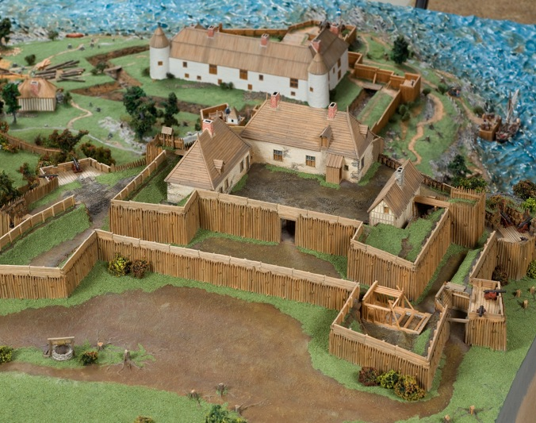
In 1699, led by Jean Baptiste de Bienville, the French tried again and built their first fort at present-day Biloxi, Mississippi.

Slide 21
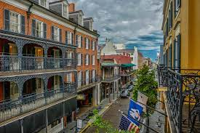
Over the years, other forts were built along the lower Mississippi including New Orleans in 1718.

Slide 22
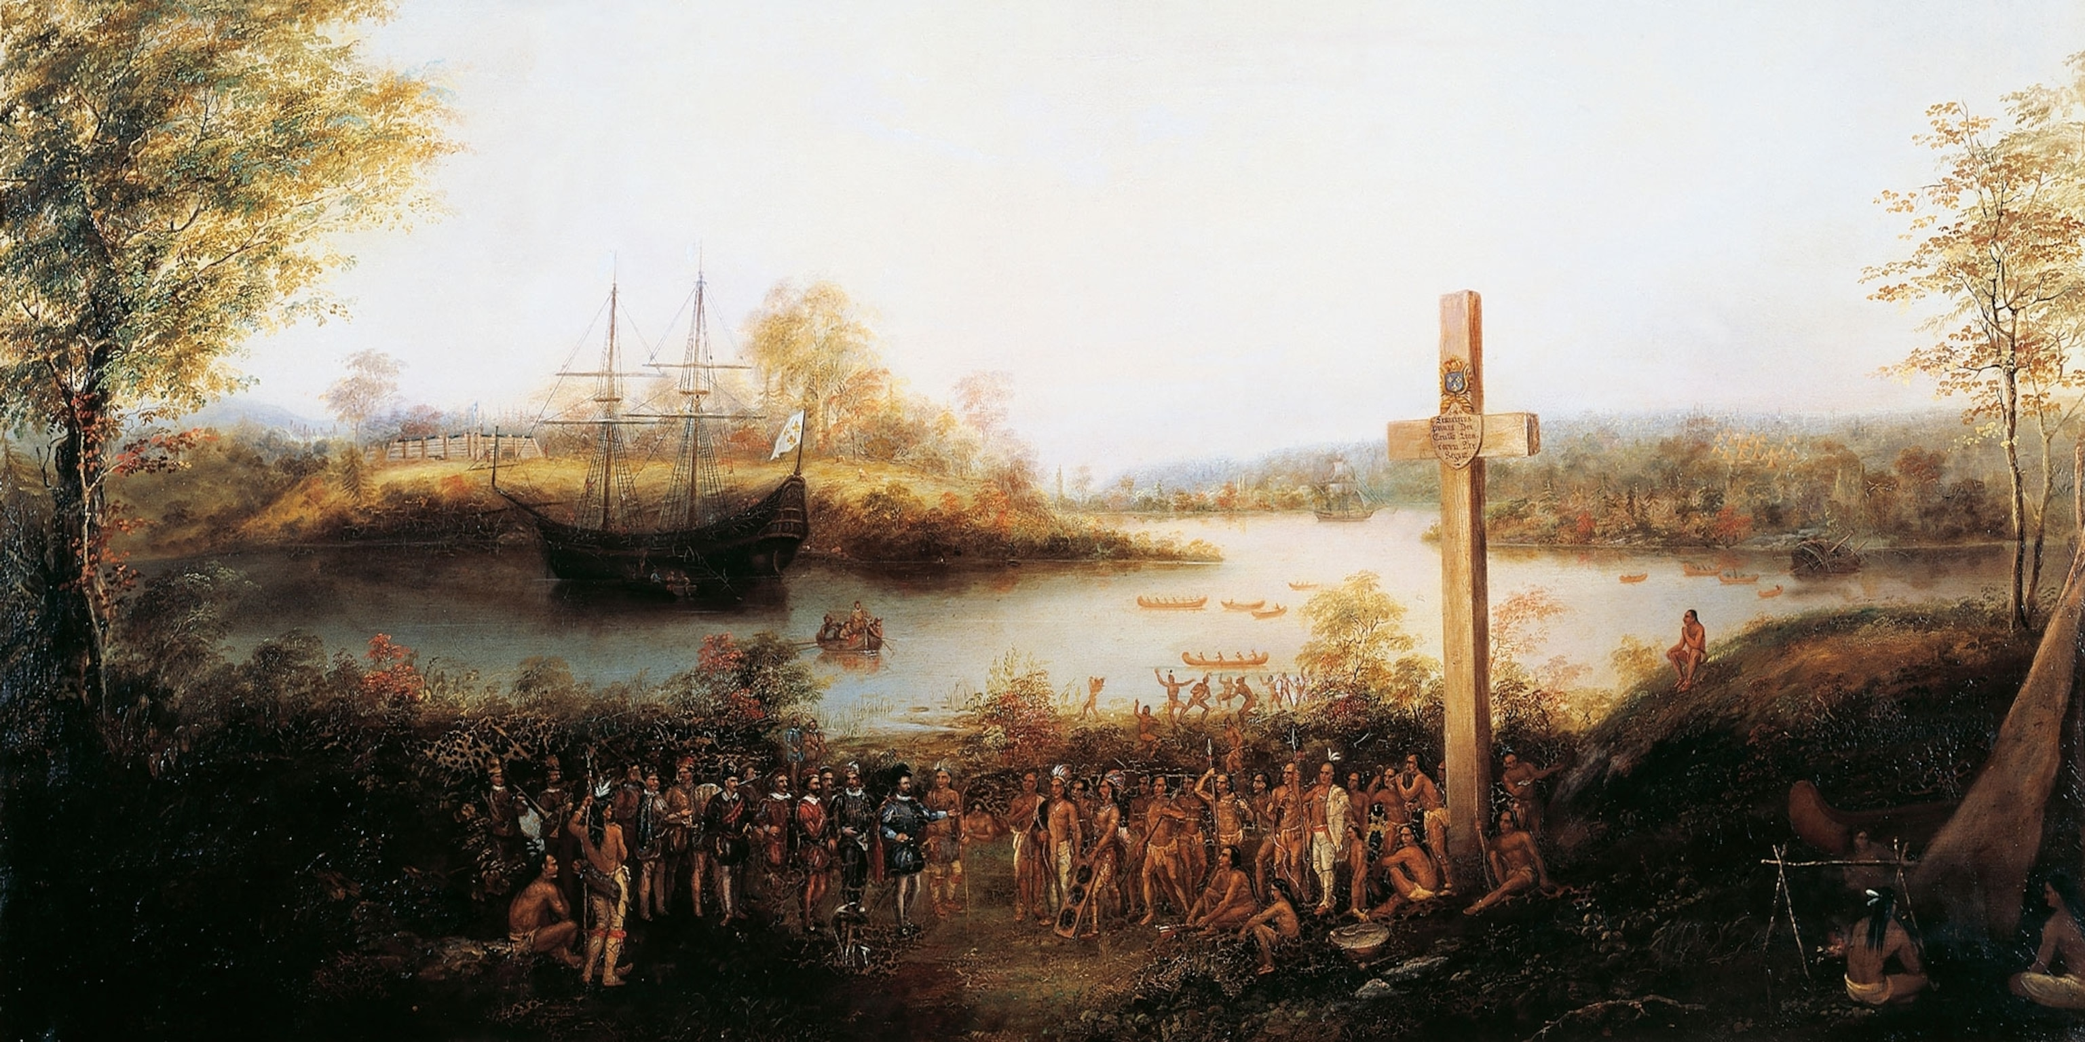
In time, even more forts were built to link the two settled parts of New France. France now held the two main access points to the American interior, the St. Lawrence River and the mouth of the Mississippi River.

Slide 23
Exit Question
What helped France in exploring the interior of the North American continent? Why was this important?

